Slide 1



DEPARTMENT OF ELECTRONICS AND COMMUNICATION ENGINEERING DESIGN OF DIGITAL FILTERS AT 60 GHz MINOR PROJECT FINAL REVIEW
PRESENTED BY:
NITHISHKUMAR C [927621BEC140]
GUIDED BY:
Dr.M.Dhamodaran,
Professor

Slide 2
Abstract
Digital filters are mandatory for digital signal processing. This paper presents a digital filter that dispels the unwanted signals or noise from the required signal and enhances the performance of the signal. The extracted features of the digital filter have been analyzed to improve the output of the signal by using the IIR Butterworth filter. It provides different designed parameters for the IIR filter to achieve the desired result. Ansys tool is considered to find out the different responses of a digital filter. About eight parameters, such as phase response, magnitude response, magnitude and phase response, step response, group delay, pole/zero plot, phase delay, and impulse response, are used to analyze the filter responses. Some selected audio signals are used for observing the empirical response of the high-pass, low-pass, band-stop filter, and band-pass filter. A special tool is developed for this observation.
Keywords— Digital Filters, Signal Processing, Responses, Impulse, Delay.

Slide 3
Objective
The aims of this research are to find out the better performance of digital filters.
To achieve this goal, it is needed to optimize the different parameters of digital filters.
Parameters like magnitude response, phase delay, phase response, group delay, impulse response, pole/zero plots and step response have been used to optimize the result and determine the better output.
To acquire the better output, IIR Butterworth filter has been used.
The cooperation between attenuation and phase response is called Butterworth filter.
Once in a while this is called a maximally flat filter because; it has no flow in the stop band or the pass band.

Slide 4
Introduction
For any kind of communication system, signal processing is the leading part.
To avoid unwanted signals, signal processing is mandatory.
Analog and digital signal processing can be used to process information.
More flexibility and better control of accuracy are provided by digital signal processing compared to analog signal processing.
Filters are applied to process the signal.
To process the raw signals, digital filters are very essential.
Different statistical methods may be introduced to observe the performance of a digital filter.
Several observation methods may also be employed in designs, and often form the origin of a filter detail.

Slide 5
SOFTWARE REQUIRED
ANYSIS SOFTWARE

Slide 6
LITERATURE SURVEY
In this paper, diverse forms of filters like high-pass filter, lowpass filter, band-stop filter and band-pass filter have been used to examine the performance of digital filter. IIR Butterworth design method is used for this design purpose. A tool is also developed for filtering audio signal. In the above research papers, all of them worked on analysis and design of IIR digital filter. Different types of design methods have been used for those analysis purposes likewindow function method, impulse invariance method and some of them used LabVIEW software for their research. the responses have been studied and analyzed based on different parameters. Also, the filter output of a selected audio signal has been examined.

Slide 7
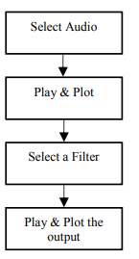
BLOCK DIAGRAM

Slide 8
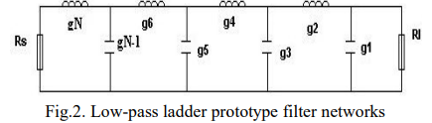
DESIGN OF LOW PASS FILTER
The lumped circuits elements are shunt capacitors and series inductors as shown in figure below

Slide 9
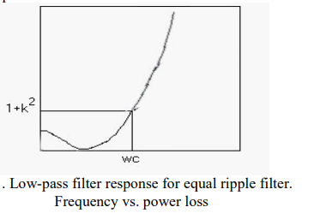

Slide 10
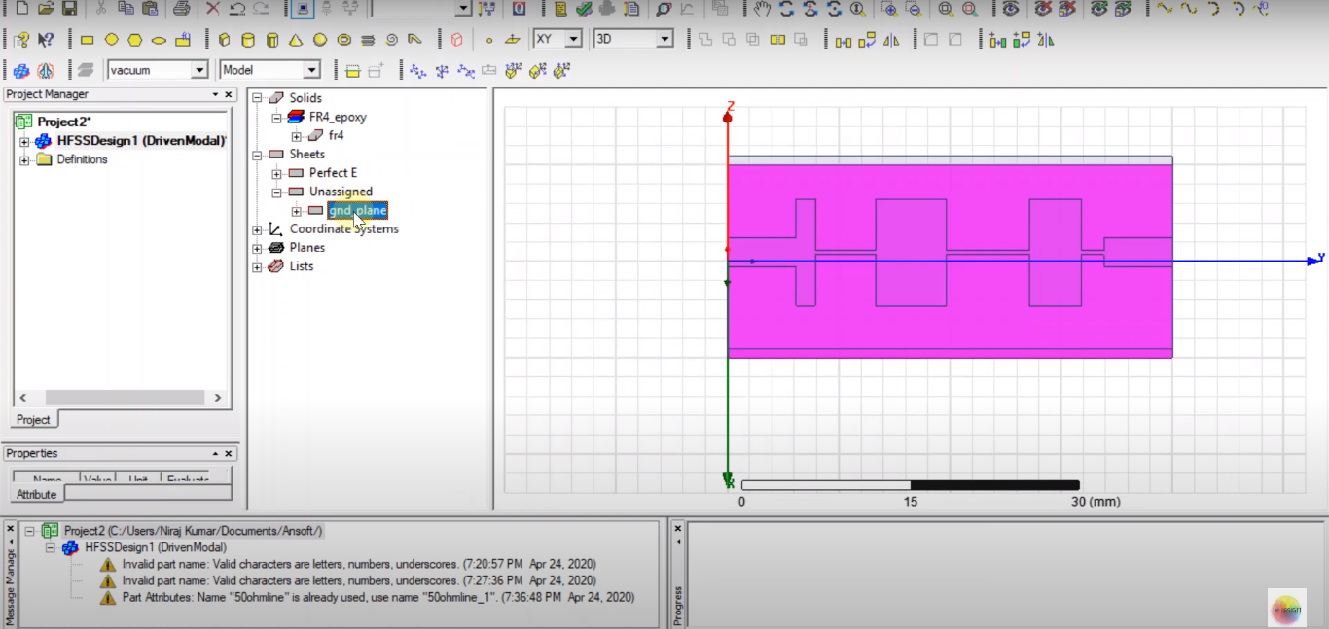
FINAL OUTPUT

Slide 11
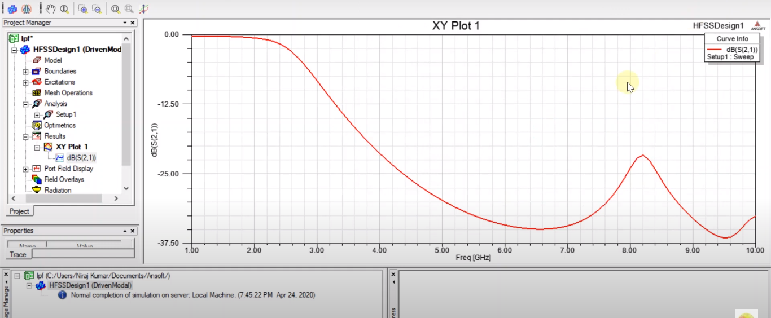
STEPPED IMPEDANCE

Slide 12
REFERENCE
James D. Broesch, Dag Stranneby and William Walker, “Digital Signal Processing: Inastant access”, 2009, pp.3.
A.K.M. Fazlul Haque, “Enviable Parameters Extraction and Enhanced Performance of Digital Filters using FDA Tool”, Journal of Bangladesh Electronic Society 9 (1), 2009
Ethan Elenberg, Stephanie Ng, Anthony Hsu, Alaap Parikh, Michelle Yu, Marc L’Heureux and E.J. Thiele, “Digital Filter Design for Audio Processing”, American journal of physics, 1965.
Ekta Yadav and Rupali, “Digital IIR Filter Design”, International Journal of Innovative Research in Technology (IJIRT), vol 1,2015
Proakis, J.G. and Manolakis, D.G., Digital signal processing: principles, algorithms and applications, Third Edition,(1996), ISBN -81-203-1129-9.

Slide 13
THANK YOU

